Slide 1


Titolo presentazione sottotitolo
SCUOLA DI INGEGNERIA INDUSTRIALE DELL INFORMAZIONE
MASTER OF SCIENCE IN AUTOMATION AND CONTROL ENGINEERING
ACADEMIC YEAR 2020-2021
ONLINE MONITORING AND FAULT DETECTION OF DISTRIBUTION TRANSFORMER WITH MACHINE LEARNING APPROACH
SUPERVISOR: CASTELLI DEZZA FRANCESCO
AUTHOR: MULLAIVENTHAN ANNA DURAI
(883406)
Milano, XX mese 20XX

Slide 2

AGENDA
AUTOMATION AND CONTROL ENGINEERING
1.Introduction & Objective of thesis.
2.IoT devices for distribution transformer.
3.Machine Learning.
4.Feature Engineering.
5.Model Training and Testing
6.Hyper Parameter Optimization.
7.Model Performance.
8.Conclusion.
9.Future Work.
POLITECNICO DI MILANO

Slide 3







INTRODUCTION AND OBJECTIVE OF THESIS
AUTOMATION AND CONTROL ENGINEERING
Most Efficient
Important Electrical Equipment
Vital in Power Industry
IoT devices for
Online Monitoring
Predictive Maintenance
Fault detection
Machine Learning
POLITECNICO DI MILANO

Slide 4
TRANSFORMER FAILURES
AUTOMATION AND CONTROL ENGINEERING
POLITECNICO DI MILANO

Slide 5




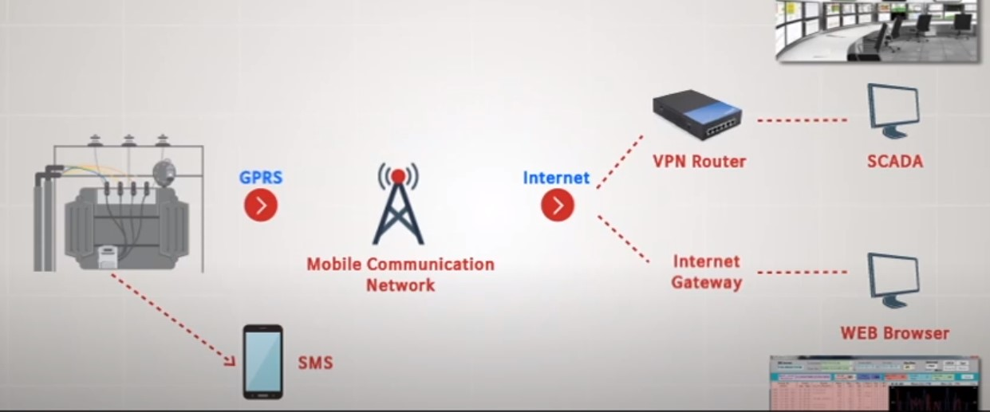
IoT DEVICES FOR DISTRIBUTION TRANSFORMER
AUTOMATION AND CONTROL ENGINEERING
IoT
DTMS Manages
Collect & Exchange Data
Transformer Overload
Oil Temperature
Loss reduction
Prevents Damage
Improved Power Quality
Notifying Fault Location
Sensor
Software
Internet
Electronics
DTMS Configuration
DTMS Measuring Parameter
Current
Voltage
Oil Temperature
Active Power
Power Consumption
Oil Level
Reactive Power
Blackout
Harmonics of Voltage
POLITECNICO DI MILANO

Slide 6










MACHINE LEARNING
AUTOMATION AND CONTROL ENGINEERING
Machine learning enables to make Data Driven Decisions.
Learns and improves over time when exposed to New Data.
Subset of AI technique which uses Statistical method.
ML Algorithm
Prediction
New Input Data
Model Input Data
Train ML Algorithm
Successful model
Training data
POLITECNICO DI MILANO

Slide 7



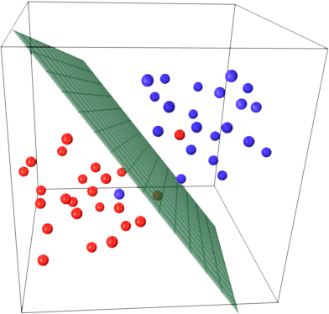
SUPPORT VECTOR MACHINES
AUTOMATION AND CONTROL ENGINEERING
Machine Learning Types
Support Vector Machines
Supervised Learning
Unsupervised Learning
Reinforcement Learning
Supervised machine learning algorithm
Classification & Regression algorithm
SVM Kernel functions
Separates data using hyperplanes
POLITECNICO DI MILANO

Slide 8
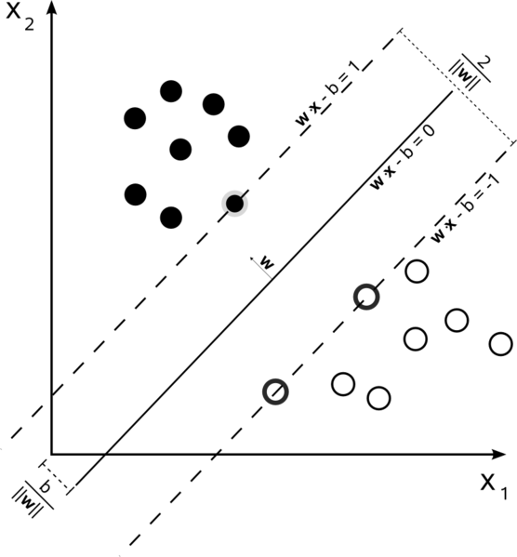
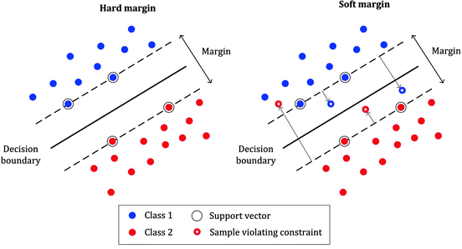
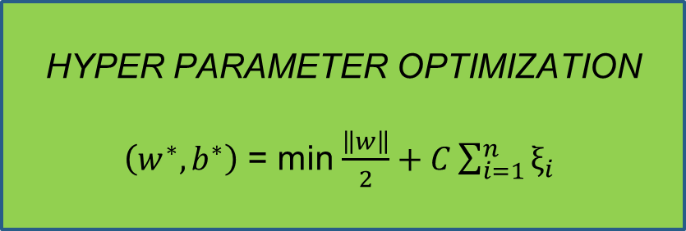
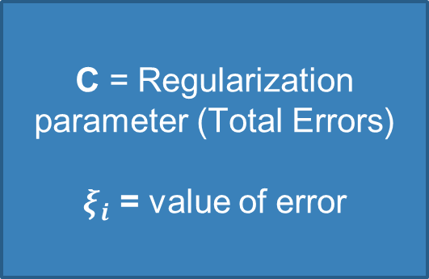
SVM HYPERPLANE WITH MARGIN
AUTOMATION AND CONTROL ENGINEERING
HYPER PARAMETER OPTIMIZATION
$\left(w^{∗},b^{∗}\right)$ = min $\frac{\left\|w\right\|}{2}+C\sum_{i=1}^{n}{ξ_{i}}$
C = Regularization parameter (Total Errors)
$ξ_{i}$ = value of error
POLITECNICO DI MILANO

Slide 9
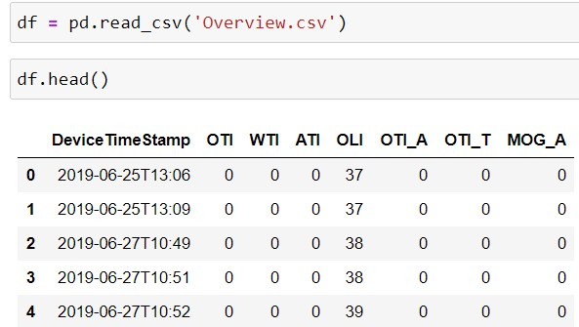
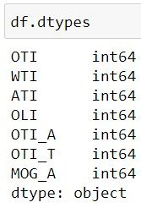
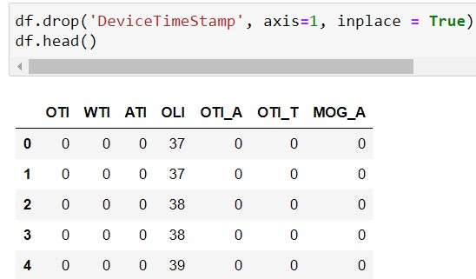
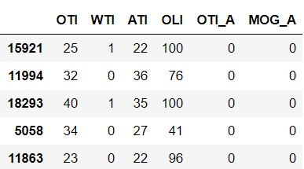







FEATURE ENGINEERING
AUTOMATION AND CONTROL ENGINEERING
Reading the dataset
Missing Data
Data cleaning
Independent Parameter (input)
OTI - Oil Temperature Indicator
WTI – Winding Temperature Indicator
ATI – Ambient Temperature Indicator
MOG_A – Magnetic Oil Gauge Indicator
Target (prediction)
OTI_T-Oil Temperature Indicator Trip
OTI_A – Oil Temperature Indicator Alarm
OLI – Oil Level Indicator
Distribution transformer monitoring datasets were collected via IoT devices from June 25^{th,} 2019 to April 14^{th,} 2020 which was also updated data for every 15 minutes.
POLITECNICO DI MILANO

Slide 10
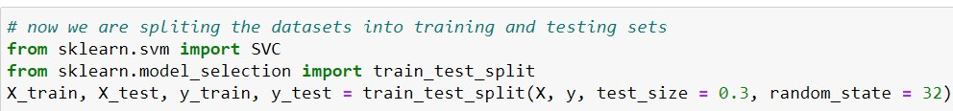
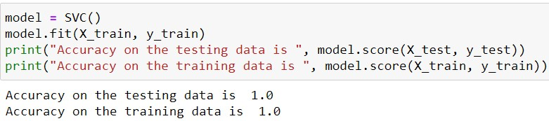
MODEL TRAINING AND TESTING
AUTOMATION AND CONTROL ENGINEERING
Splitting the data into Training and Testing set
Model fitting
POLITECNICO DI MILANO

Slide 11
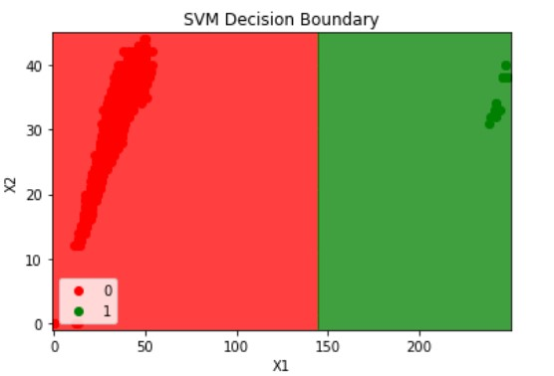
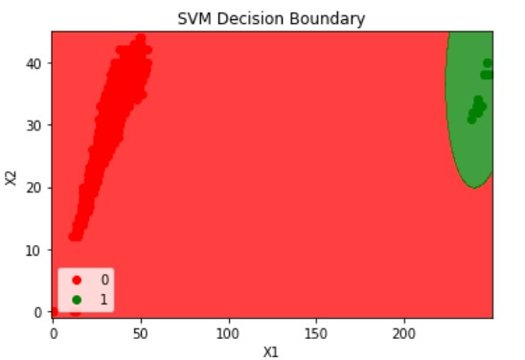
SVC DECISION BOUNDRY
AUTOMATION AND CONTROL ENGINEERING
SVM Linear classifier
SVM RBF Classifier
Green points represent Fault
Red points represents No Fault
POLITECNICO DI MILANO

Slide 12
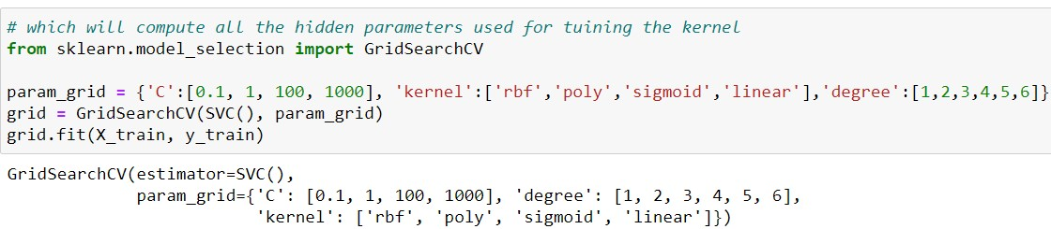
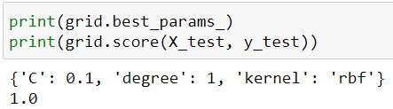
HYPER PARAMETER TUNNING GRID SEARCH CV
AUTOMATION AND CONTROL ENGINEERING
For kernels: RBF, poly, sigmoid, linear
C = 0.1
Degree = 1
Best kernel = RBF
Accuracy score = 100
Best hyper parameter and kernel
POLITECNICO DI MILANO

Slide 13
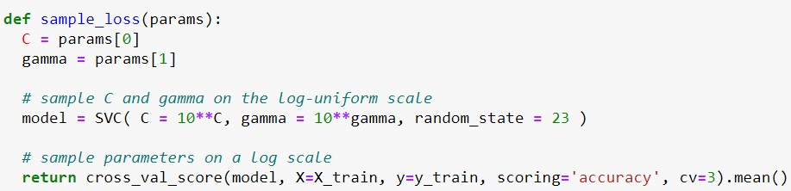
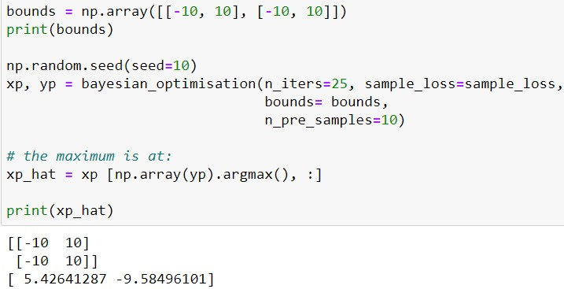
HYPER PARAMETER TUNNING BAYESIAN OPTIMIZATION
AUTOMATION AND CONTROL ENGINEERING
Defining the loss function
Defining boundary for Bayesian opt
[-10,10]
Best values for
C = 5.42
Gamma = -9.5
POLITECNICO DI MILANO

Slide 14
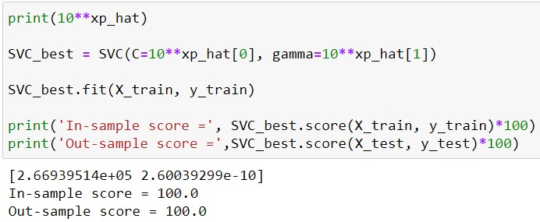
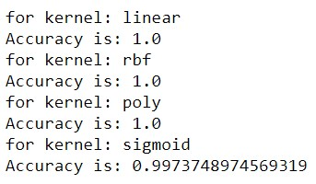
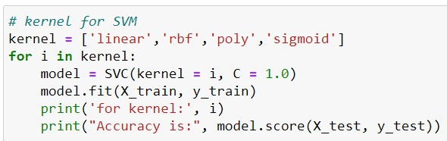
ACCURACY SCORE
AUTOMATION AND CONTROL ENGINEERING
Bayesian Accuracy score for
optimal C & Gamma
SVM kernels
POLITECNICO DI MILANO

Slide 15
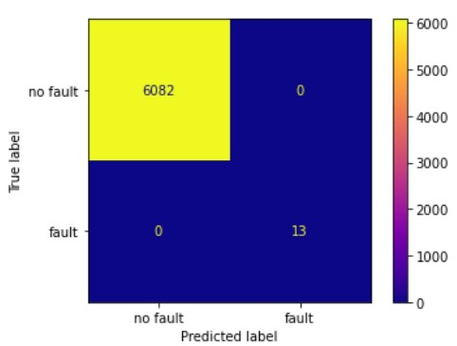
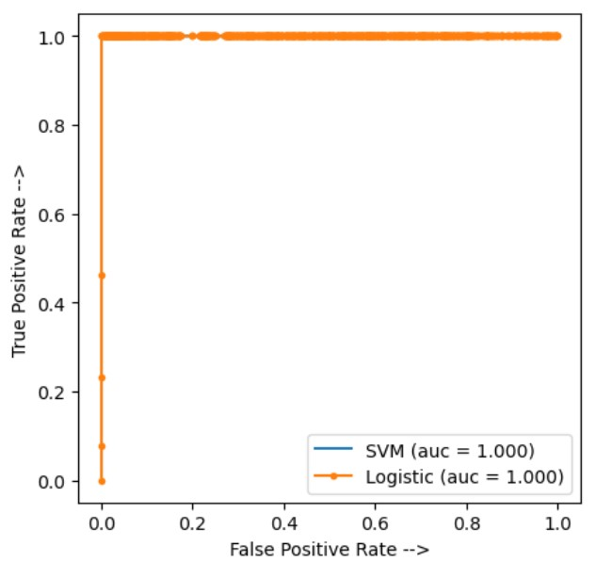
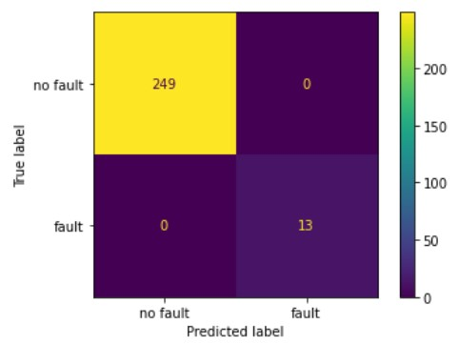
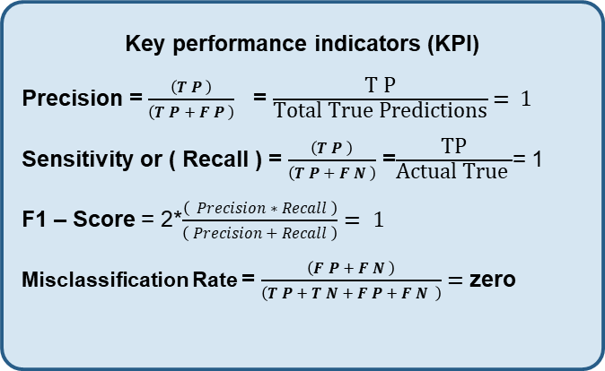
MODEL PERFORMANCE
AUTOMATION AND CONTROL ENGINEERING
Confusion matrix
ROC & AUC Curve
True Positive = 13
(Fault Condition)
True Negative = 6082
(No Fault Condition)
Classifier Separating the classes perfectly as ROC is close to Upper left corner of the plot.
Down sampled data
Key performance indicators (KPI)
Precision = $\frac{\left(T P \right)}{\left(T P + F P \right)}$ = $\frac{\text{T} \text{P}}{\text{Total} \text{True} \text{Predictions}}$ = 1
Sensitivity or ( Recall ) = $\frac{\left(T P \right)}{\left(T P + F N \right)}$ =$\frac{\text{TP}}{\text{Actual} \text{True} }$= 1
F1 – Score = 2*$\frac{\left( Precision ∗ Recall \right)}{\left( Precision + Recall \right)}= 1$
Misclassification Rate = $\frac{\left(F P + F N \right)}{\left(T P + T N + F P + F N \right)}=$zero
True Positive = 13
(Fault condition)
True Negative = 249
(No Fault Condition)
POLITECNICO DI MILANO

Slide 16


CONCLUSION
AUTOMATION AND CONTROL ENGINEERING
Support Vector Machine is the best algorithm for predicting Fault in the distribution transformer.
Best kernel is RBF
Open-Source Programming Software jupyter notebook-Python is used for coding.
Feature Engineering, Model Selection, Hyper Parameter Tunning, Model Performance has been provided through this research work.
POLITECNICO DI MILANO

Slide 17
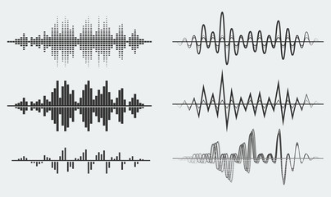
FUTURE SCOPE
AUTOMATION AND CONTROL ENGINEERING
In future, we can include vibration data of the transformer and make our model even more accurate.
From this method we can also predict the mechanical failures of the transformer.
POLITECNICO DI MILANO

Slide 18

AUTOMATION AND CONTROL ENGINEERING
POLITECNICO DI MILANO

